Slide 1
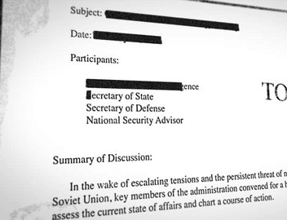
Protective Vision
A Computer Vision Approach to Sensitive Information Detection and Hiding in Social Media Content
Presented By:
  Muqeet Ahmad
  Ahmad Shafique
Supervised By:​
  Dr. Muhammad Safyan

Slide 2
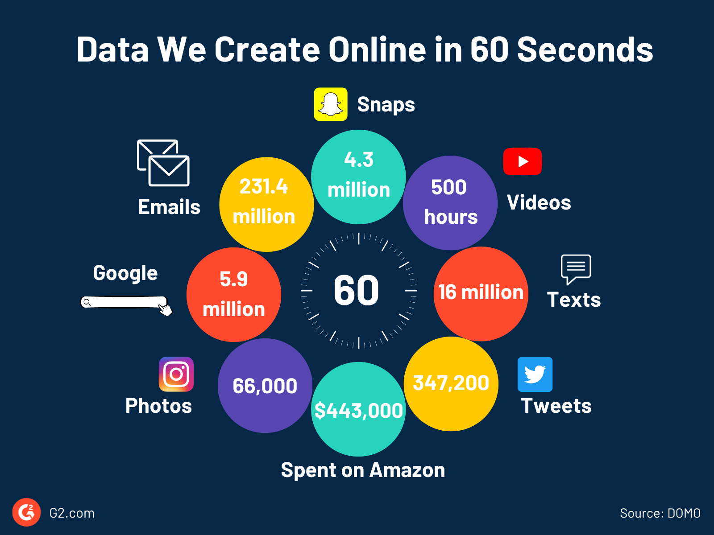
Background
The amount of data produced and shared online is increasing at an exponential rate, leading to growing privacy vulnerabilities.
Sharing sensitive information on social media can result in social engineering attacks and privacy breaches.
Your vehicle number plate can be misused by unauthorized individuals, potentially leading to legal or criminal implications.
Your bank card left visible in a casual photo may expose confidential details.
Your contact number or email address can be leaked unknowingly through platforms like WhatsApp statuses or stories.

Slide 3
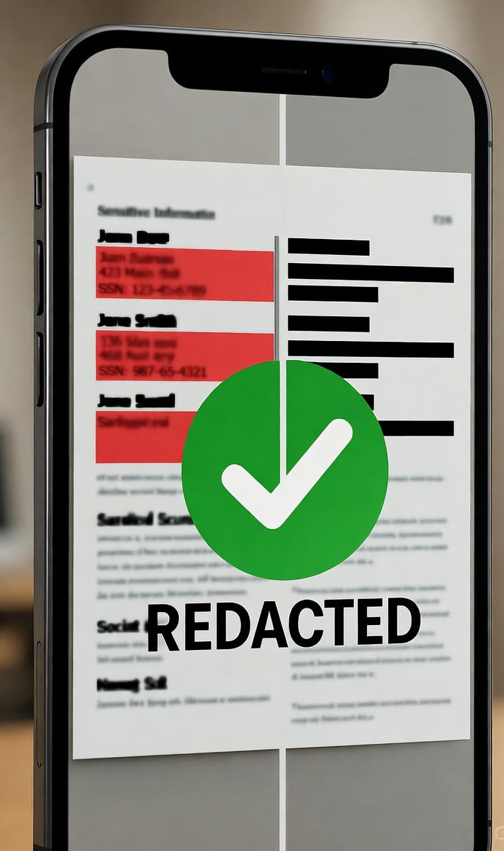
Literature Review
Current systems focus only on detection, not redaction
No single tool handles multiple types of sensitive info
Most systems are cloud/desktop-based — not mobile-friendly
Detection without masking risks exposure
One-click solution to redact everything

Slide 4
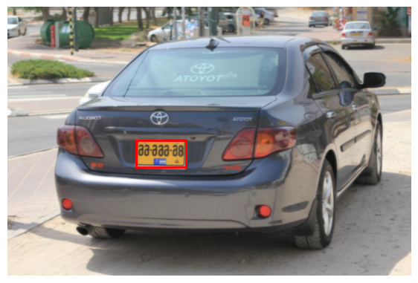
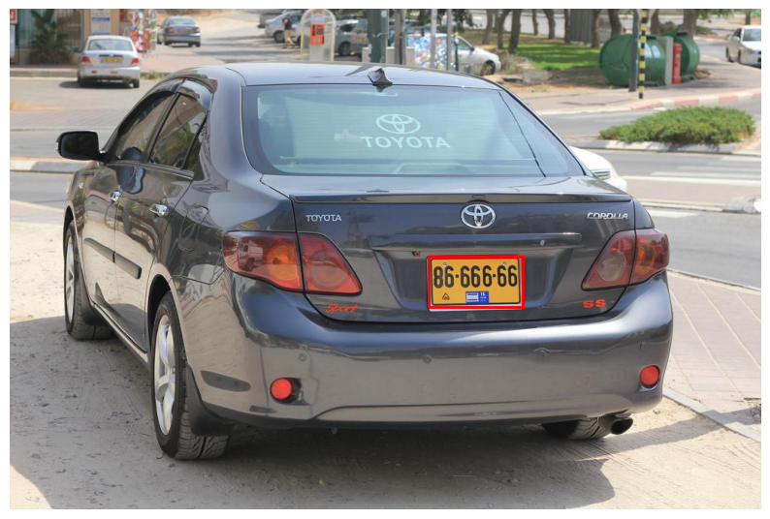
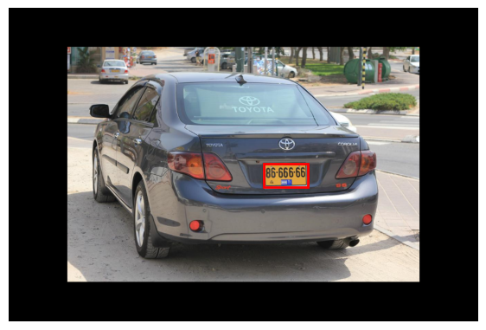
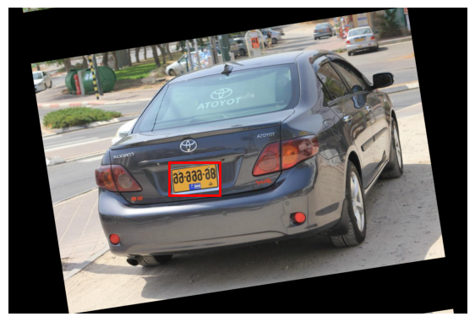
Dataset, Augmentation and Training
Type | Original | Augmented | Total | Training | Testing | Validation
Vehicle Plate | 6200 | 5589 | 11789 | 8252 | 1768 | 1769
Banking Card | 1350 | 1215 | 2565 | 1795 | 385 | 385
After Augmentation
Original Image

Slide 5
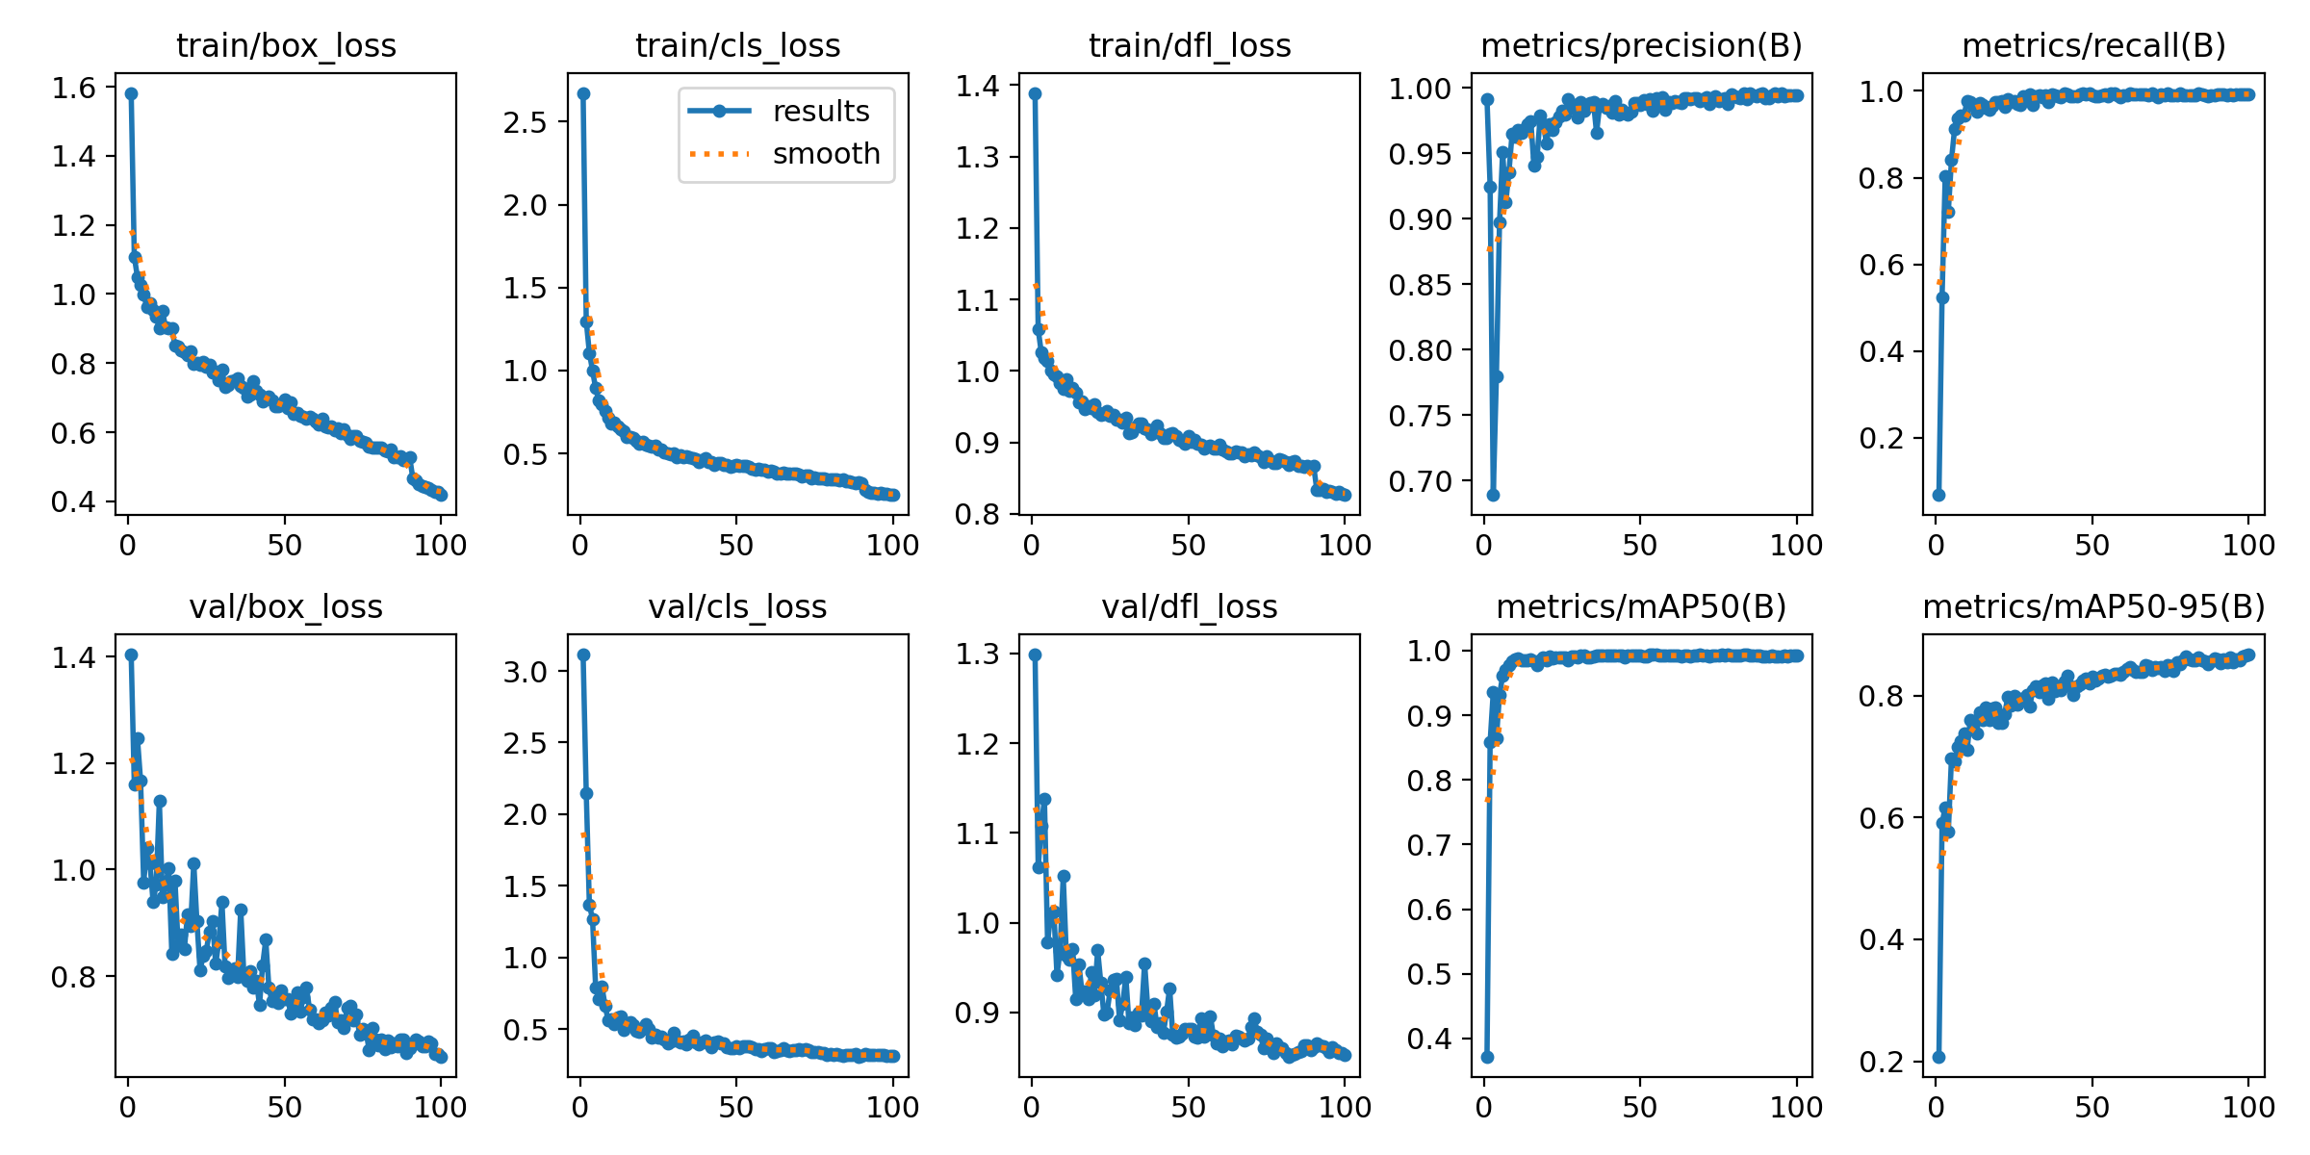
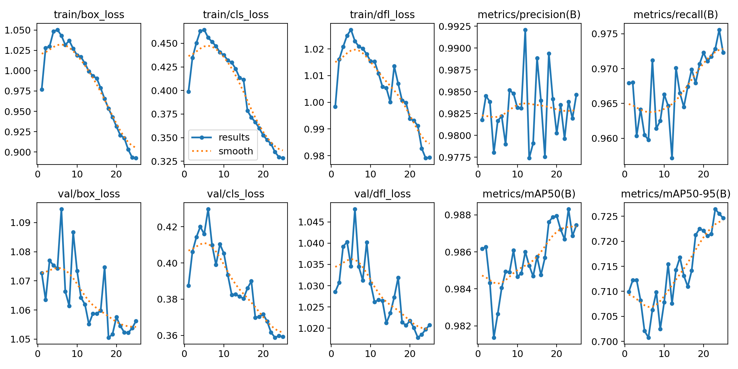
Model Training & Results
Plate Model
Card Model

Slide 6
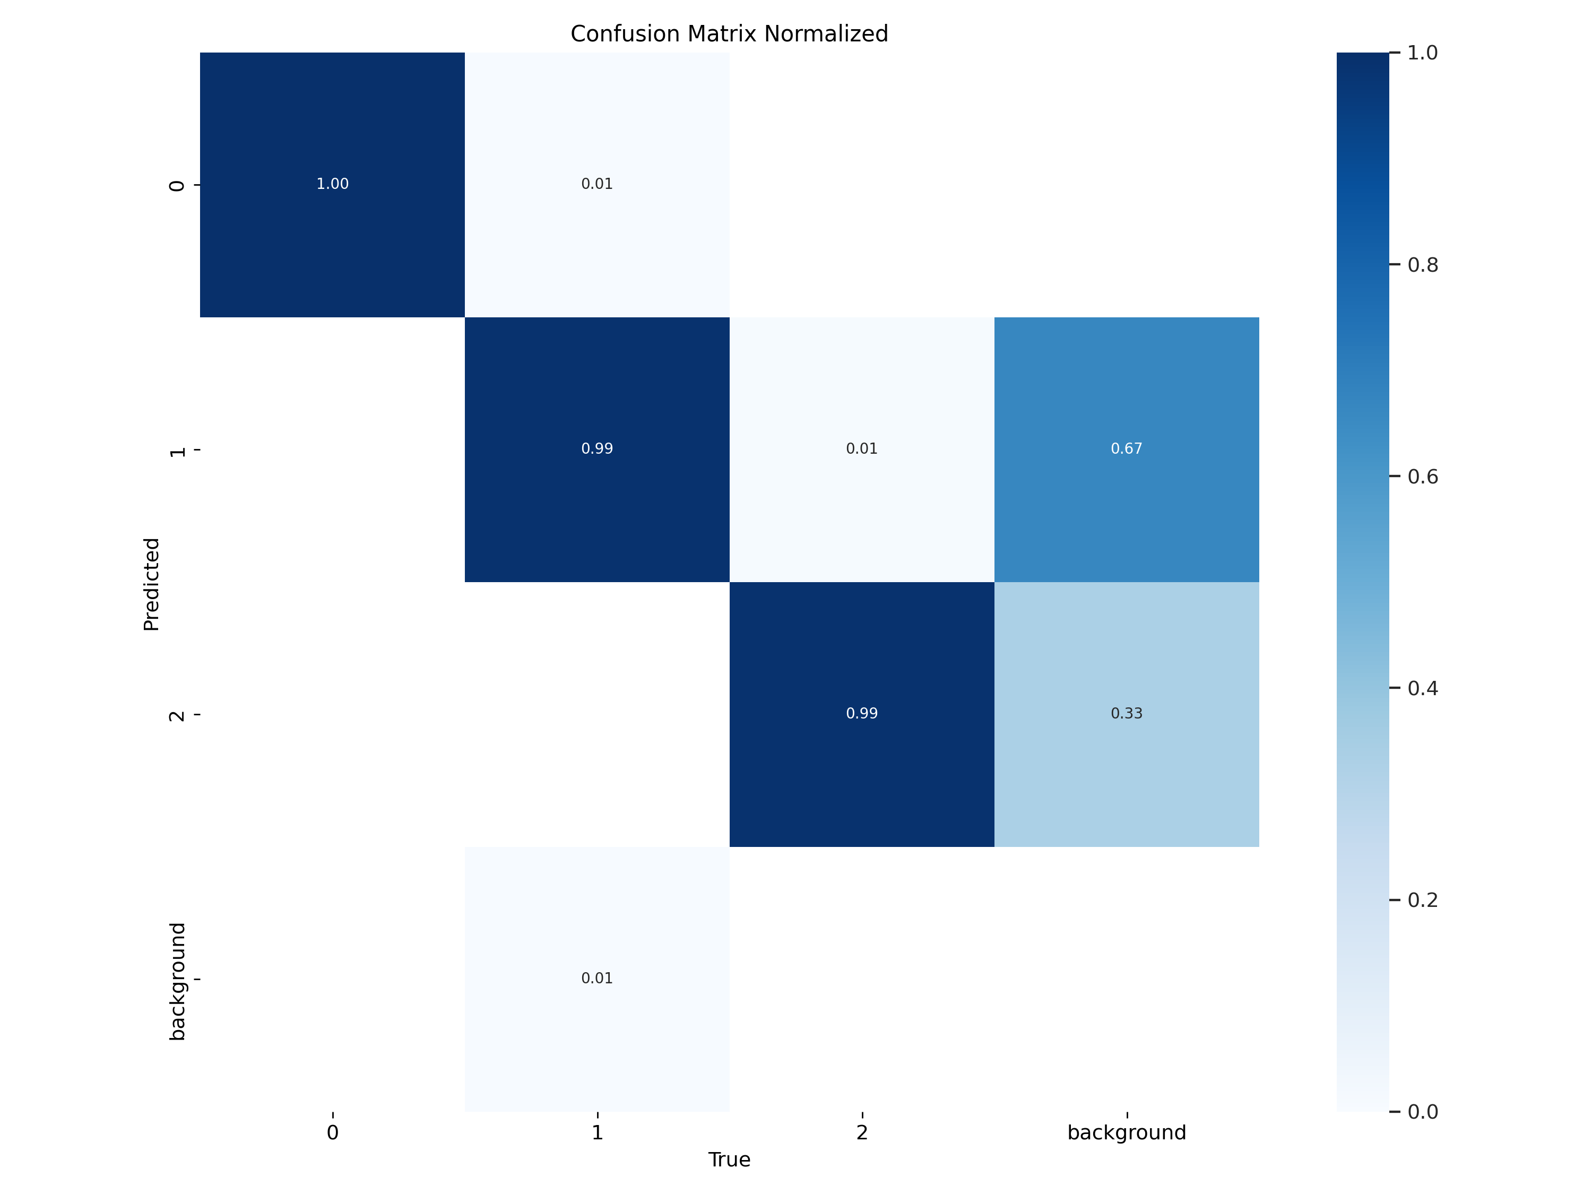
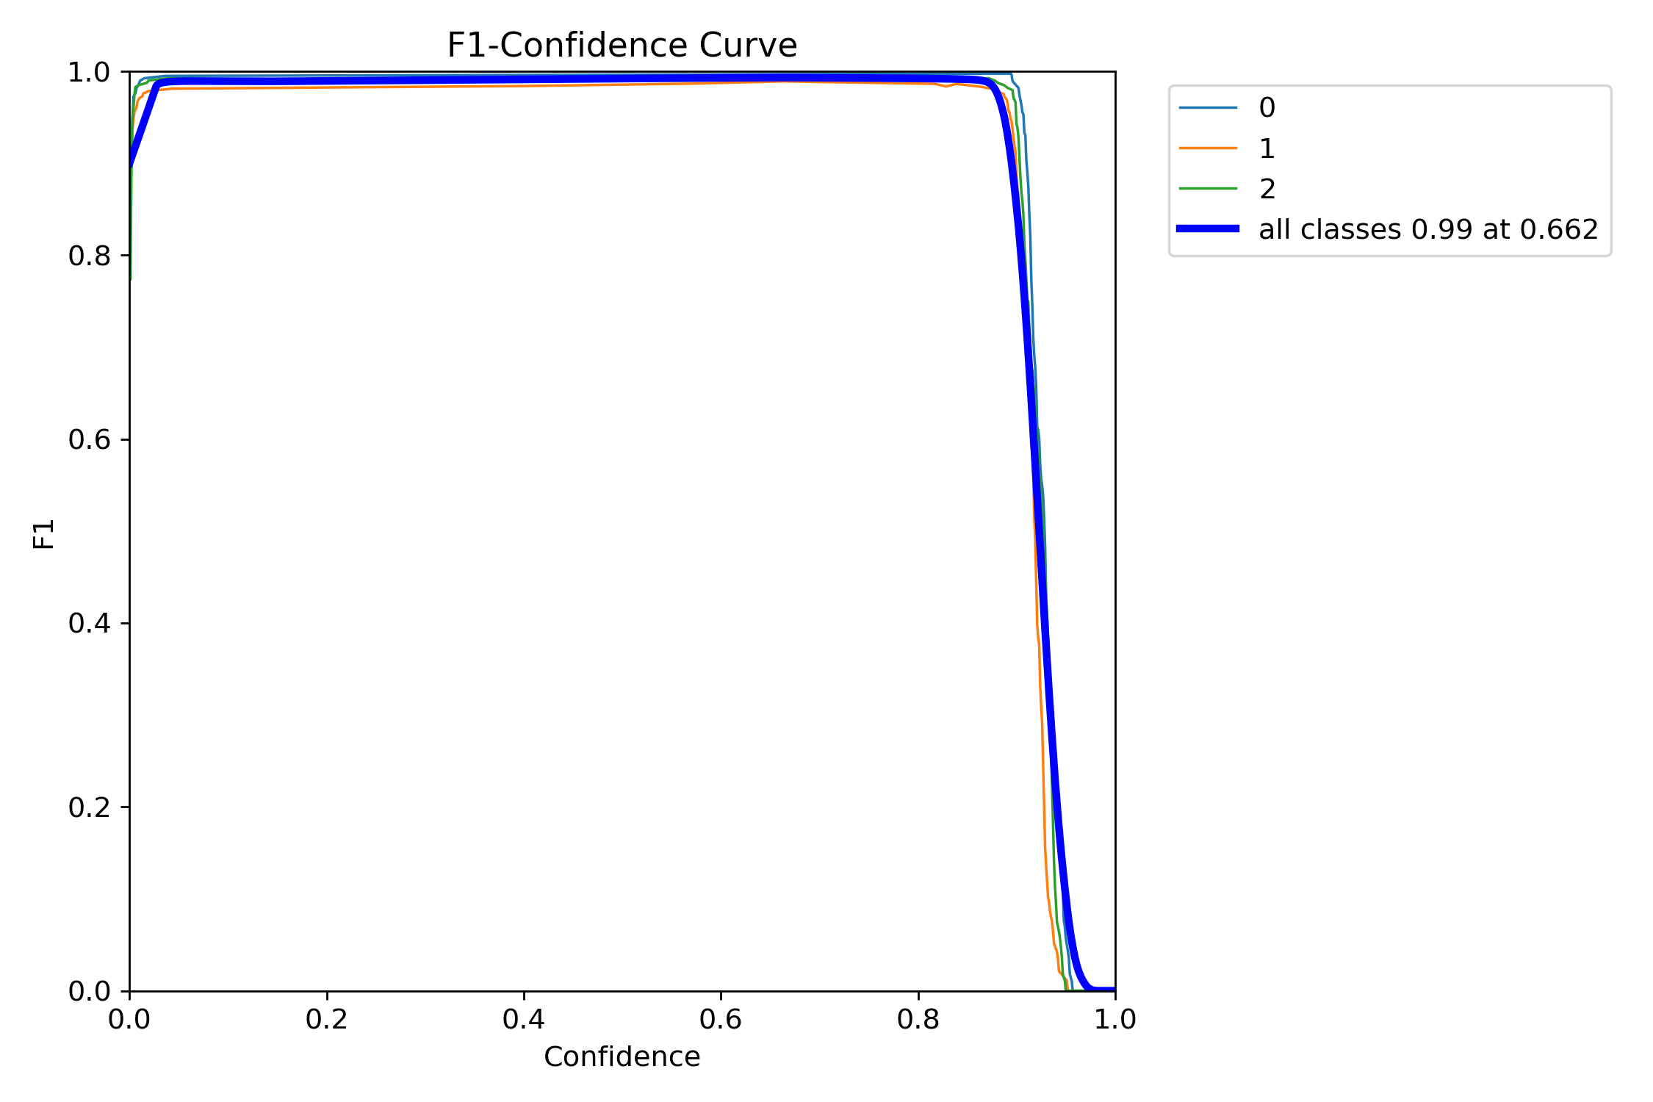
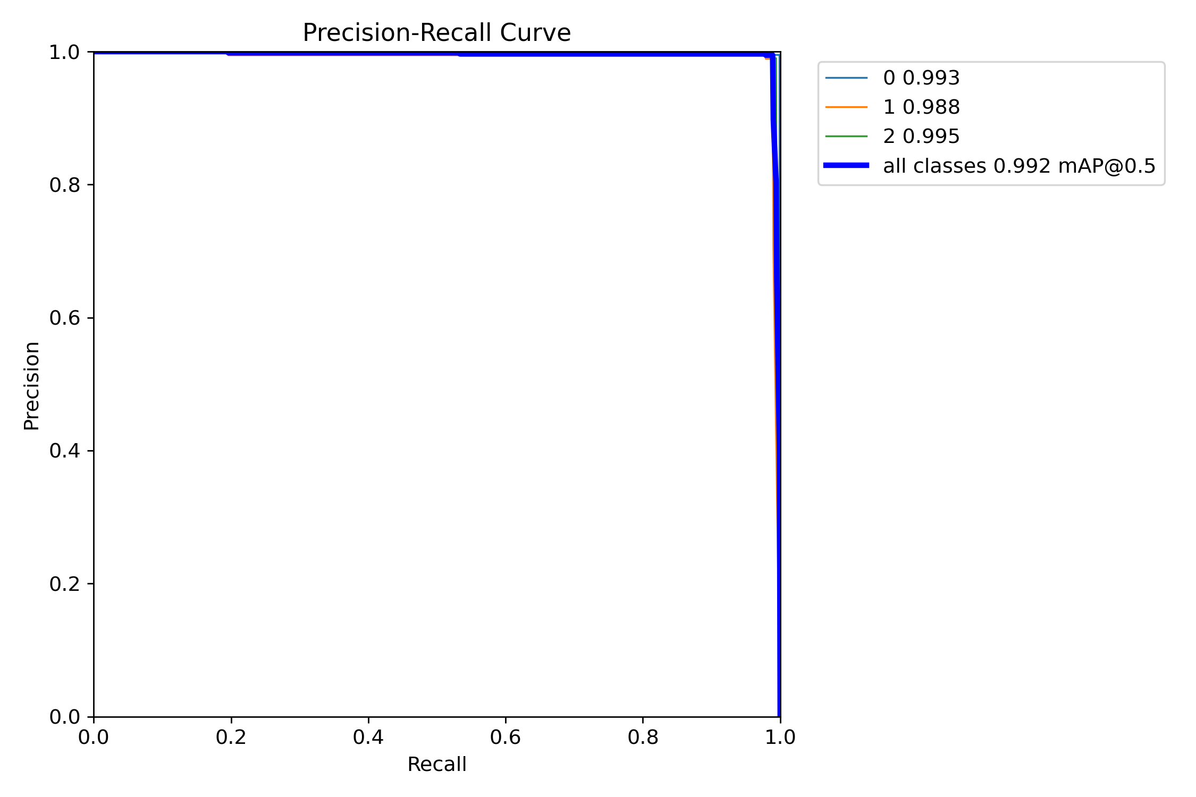
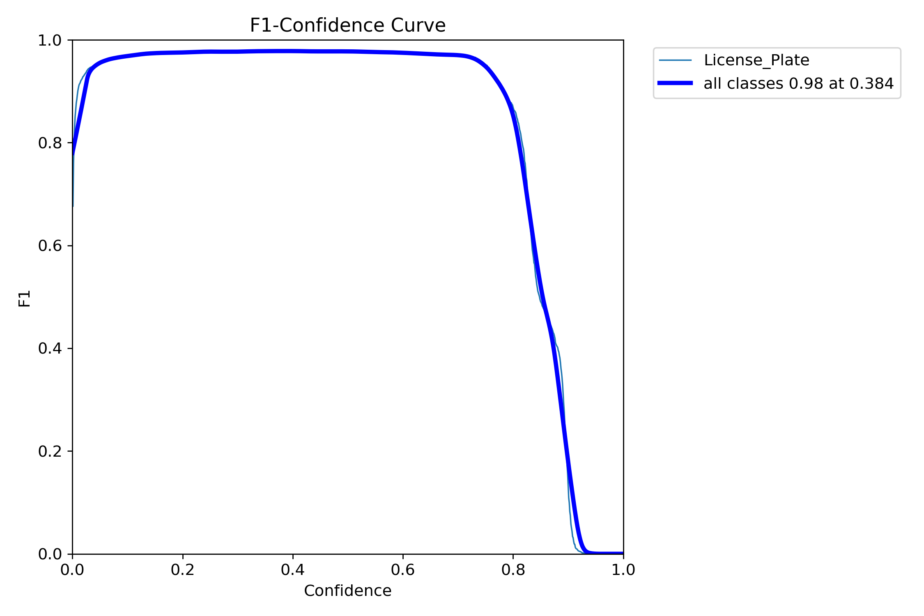
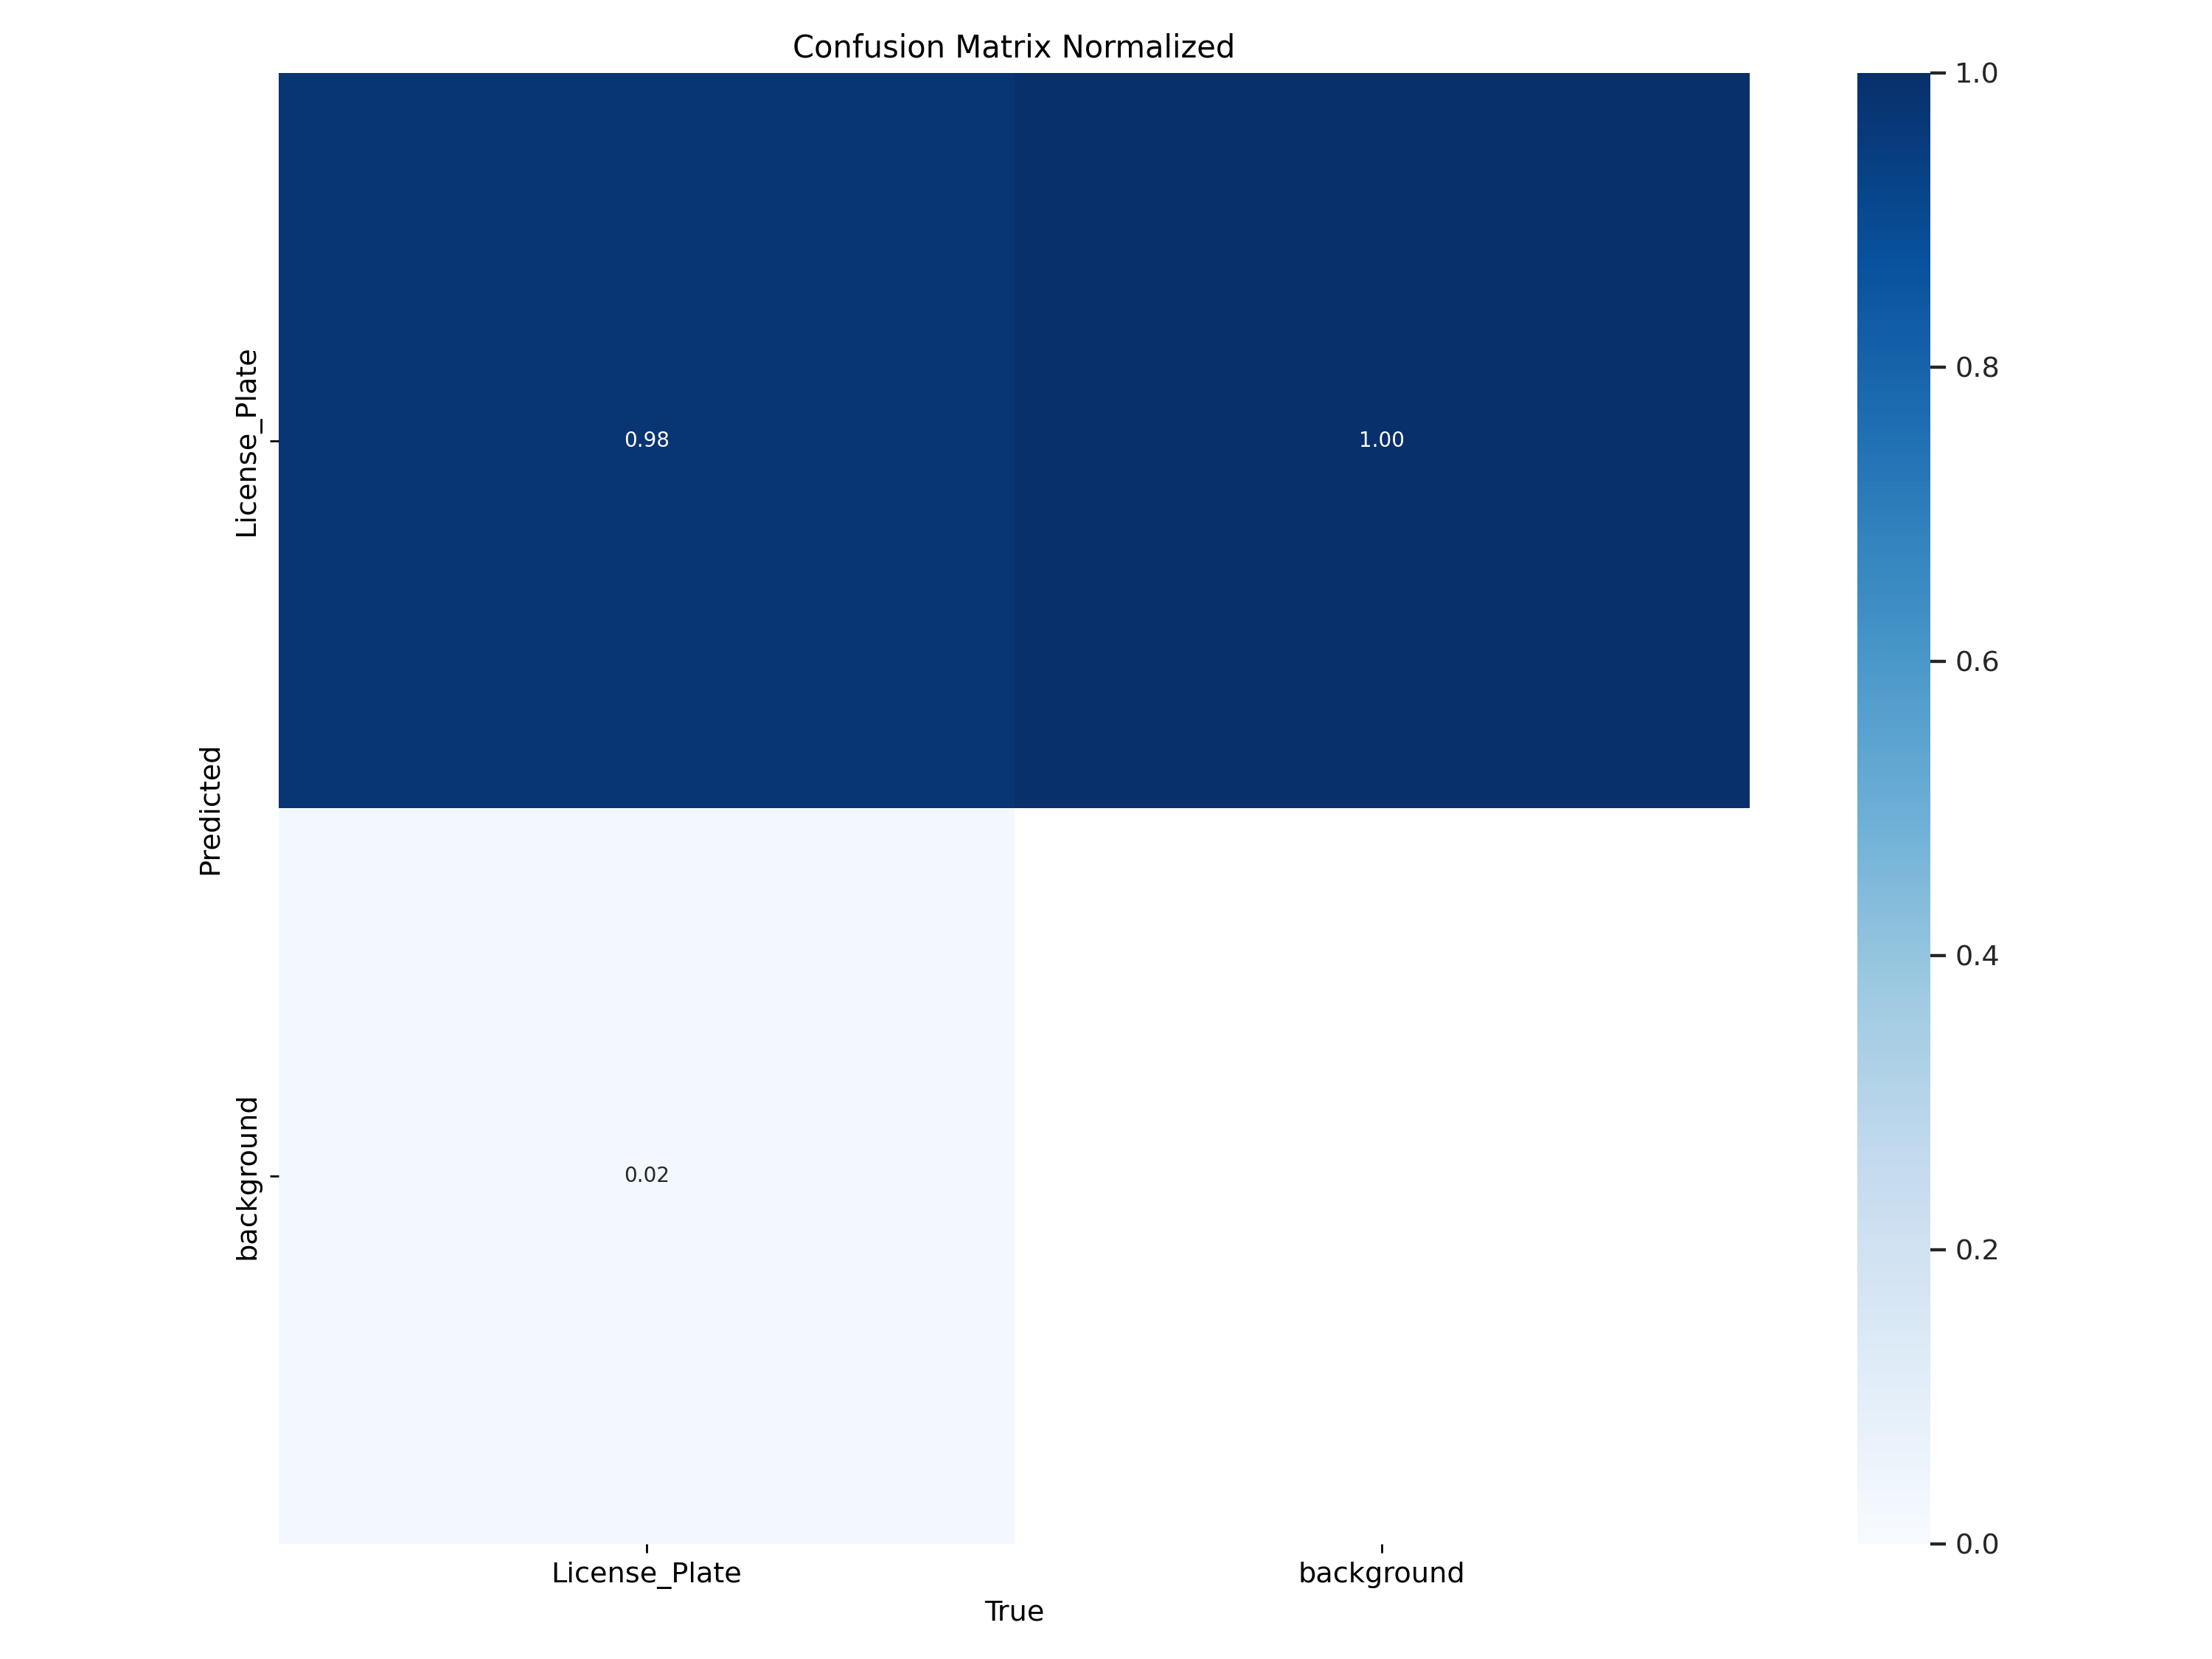
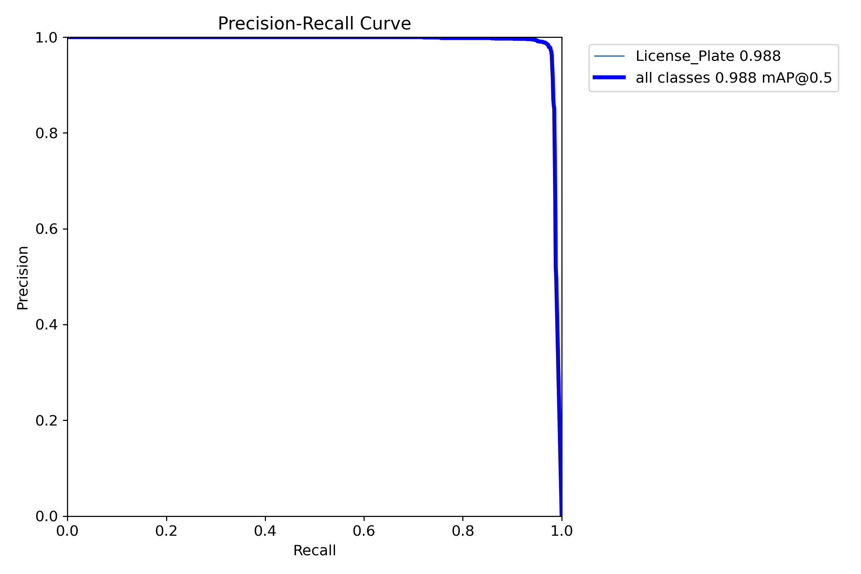
Evaluation
Metrics

Slide 7
Evaluation Metrics
For the license plate model, training stabilized around 60 epochs. The final evaluation achieved a precision of 98.5%, a recall of 96.7%, and a mean Average Precision at IoU 0.5 of 98.9%. The stricter mAP@0.5–0.95 stood at 72.6% reflecting reason able performance under varying IoU thresholds. While precision is high, recall is the more critical number here. A recall of 96.7% means that most plates were detected and masked. Only a very small fraction might slip through without being hidden, and that is the risk we want to keep as low as possible.
The banking card model needed more training, about 100 epochs, due to the smaller data set. The results were even stronger, with precision at 99.4%, recall at 99.2%, and mAP@0.5 at 99.2%. Its stricter mAP@0.5–0.95 reached 86.7%, higher than the plate model. Once again, recall is the key metric. At 99.2%, the model missed almost no card instances. This is crucial since even a single uncovered card detail, like a number or CVV, could enable unauthorized transactions. Extra masking from false positives is acceptable, but missing a true card detail is not.

Slide 8
System Flowchart
Returns
Processed img/vid
Processing Type
Total Detections
Plate
Returns Bounding Boxes
User Input
Image/video
Model to use
Fast_mode
Card
Gaussian Blur
Output
EasyOCR
Gemini
Gamma 3n
Text Extraction
Semantic Validation

Slide 9
Application interface here

Slide 10









Tools & Technologies

Slide 11
Conclusion
This project implemented a computer vision–based framework capable of detecting and concealing sensitive information in visual media.
High precision and recall across multiple models validate the system’s robustness and reliability.
The proposed approach demonstrates significant potential for real-world deployment in enhancing user privacy and data protection.
By integrating advanced detection with automated redaction, Protective Vision contributes toward developing secure, ethical, and intelligent privacy-preserving systems.

Slide 12
Future Work
Extend detection beyond plates and cards to include ID cards, handwritten notes, QR codes, and official documents.
Use lighter YOLO versions, model pruning, and compression for faster results.
Ensure smooth real-time on-mobile processing even on low-end smartphones.
Integrate into OLX, PakWheels, or other platforms for automatic privacy protection in user-uploaded images.
Add features like customizable masking styles, multilingual OCR, and voice commands.
Research to be continued

Slide 13

Thank
You
Any Questions?

